Slide 1

Keenan Hollow
SOFTWARE
Shannon Knox, Founder and CEO
Samuel Butler, Analyst

Slide 2
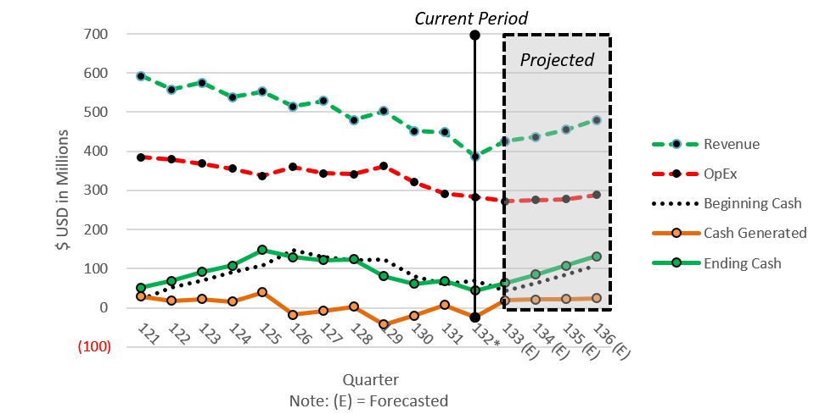
Financial Position

Slide 3
Risks Factors
1) Quick Ratio = 0.119 for current quarter
For every $1 USD in Operational Expenses, $0.119 USD on hand
Very Large Expenses | Very Little Cash
2) $44 M Cash on Hand | Before $40 M Payment
Last 5 of 7 Quarters were Not Profitable
3) Some Uncertainty with Launch of New Product
4) BBB Rating and Increase in Cost of Capital
Increase of +450bps in 18 months
Banks view Current Position as Risky

Slide 4
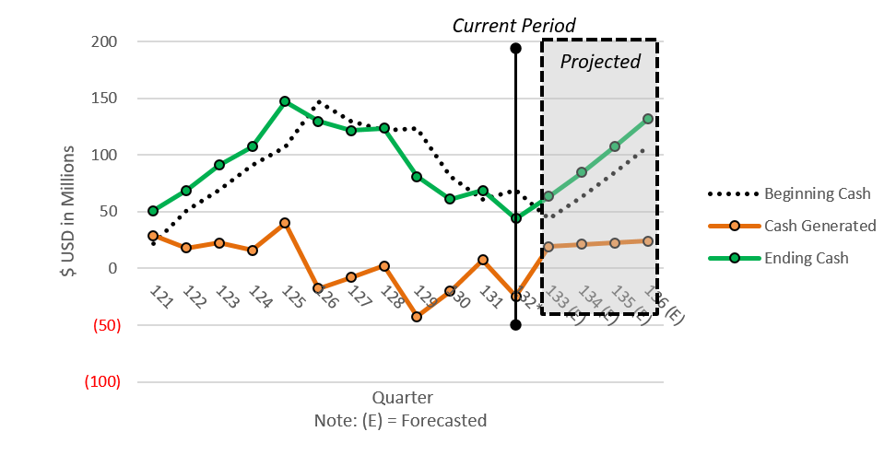
Financial Position

Slide 5
Advantage of Refinancing
1) $35 M in Cash on Hand
After $9 M Fee
2) Maintain Flexibility to Support Software Launch
Financing to Support Contingency Plans
3) Maintain Marketing Capability / Promotional Budget
4) Relative Increase in Cost of Capital
With trends, Capital will be Cheaper Now than in the Future

Slide 6
Recommendations
- Refinance the $40 M Loan
- Launch the New Software Package
- Use Refinanced Cash to Mitigate Risk | Maintain Flexibility
- Payoff Loans as Keenan Hollow Position Improves

